Slide 1
Constants, Data Types, and Operators

Slide 2
Programming language
Every program instruction must confirm precisely to the syntax rules of the language.
C has its own vocabulary and grammar.

Slide 3
Character Set
C characters are grouped into the following
categories.
  Letters
  Digits
  Special Characters
  White Spaces

Slide 4
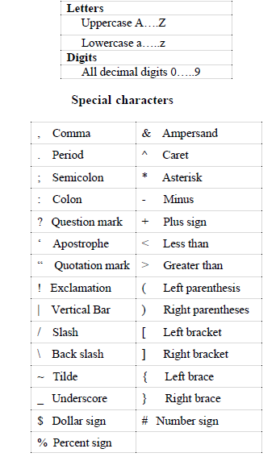
Character Set…

Slide 5
White Space
Blank Space
Horizontal Tab
New Line
etc

Slide 6
C Tokens
In C programs, the smallest individual units are known as tokens.
C programs are written using these tokens and the syntax of the language.

Slide 7
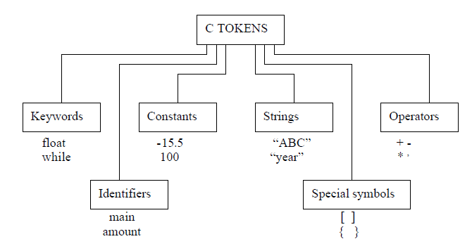
C Tokens…

Slide 8
Keyword
Every C word is classified as either a keyword or an identifier.
All keywords have fixed meanings and these meanings cannot be changed.
Example: auto, break, char, void etc.,

Slide 9
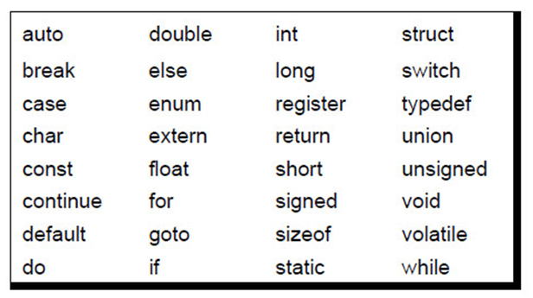
Keyword (Cont…)

Slide 10
Identifiers
Identifiers refer to the names of variables, functions and arrays.
They are user-defined names and consist of a sequence of letters and digits, with a letter as a first character.
Both uppercase and lowercase letters are permitted. The underscore character is also permitted in identifiers.

Slide 11
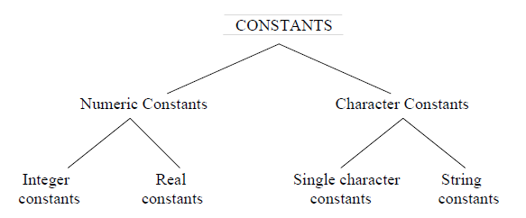
Constants
Constants in C refer to fixed values that do not change during the
execution of a program.

Slide 12
Constants(Cont.)
Single Character Constant
A single character constants contains a single character enclosed within a pair of single quote marks.
Eg: ’5’
‘X’
‘;’

Slide 13
Constants(Cont.)
String Constants
A string constant is a sequence of characters enclosed in double quotes.
The characters may be letters, numbers, special characters and blank space.
Eg:”Hello!”
“1987”
“?….!”

Slide 14
Constants(Cont.)
Backslash Character Constants
C supports special backslash character constants that are used in output functions.
These character combinations are known as escape sequences.

Slide 15
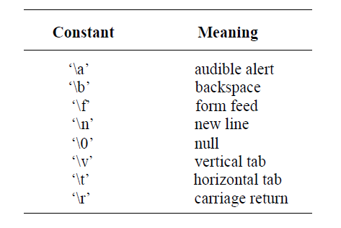
Backslash Character Constants

Slide 16
printf function
  printf(“Integer values\n\n”);
  printf(“%d”, 32);
  printf(“ Total Value = %d”, 32 + 8);
  printf(“ Total Value = %f”, 32.5);
  printf(“ Total Value = %c”, ‘B’);
  printf(“Total value = %ld”, 10L);
  printf(“Total value =%lf”, 234.45);
  printf(“Name is =%s”, “Arif”);

Slide 17
Variable
A variable is a data name that may be used to store a data value.
A variable may take different values at different times of execution and may be chosen by the programmer in a meaningful way.
It may consist of letters, digits and underscore character.
Eg: 1) Average 2) Height

Slide 18
Rules for defining variables
They must begin with a letter. Some systems permit underscore as the first character.
ANSI standard recognizes a length of 31 characters. However, the length should not be normally more than eight characters.
Uppercase and lowercase are significant.
The variable name should not be a keyword.
White space is not allowed.

Slide 19
Data types
ANSI C supports four classes of data types.
Primary or Fundamental data types.
User-defined data types.
Derived data types.
Empty data set.

Slide 20
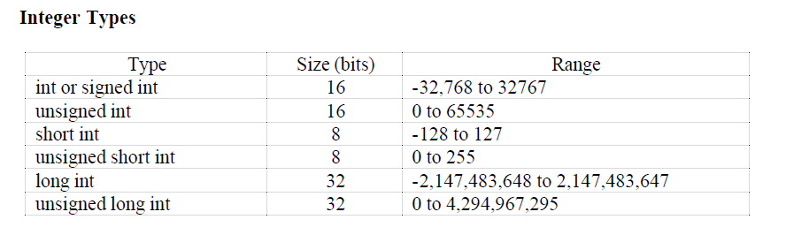
Data types(Cont.)

Slide 21
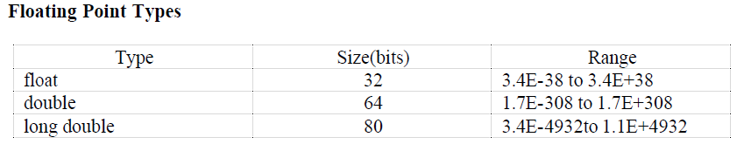
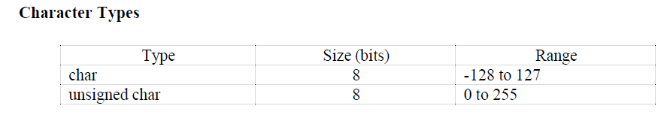
Data types(Cont.)

Slide 22
Declaration Of Variables
It tells the compiler what the variables name is.
What type of data the variable will hold.
The syntax is
data-type v1,v2…..vn;
Eg:1. int count;
float ratio, total;

Slide 23
/* Test1.c: This is my first C program */
#include <stdio.h>
int main()
{
float avg, a, b;
avg = 0.0;
a = 1;
b = 16;
/* This is the average of two floating numbers*/
avg = (a + b)/2;
printf (“ Average = %f ", avg);
return 0; }

Slide 24
Reading from keyboard
Integer number:
scanf("%d",&number);
Float number:
scanf("%f",&number);
Character number:
scanf("%c",&number);

Slide 25
This is the Sum of two integer numbers from keyboard
# include <stdio.h>
int main( )
{
int num1, num2, sum = 0;
printf ("Enter Numbers\n");
scanf("%d%d", &num1, &num2);
sum = num1 + num2;
printf (“ Sum = %d\n", sum);
return 0;
}

Slide 26
OPERATORS OF C
C operators are classified into a number of categories.
They include:
1. Arithmetic operators
2. Relational operators
3. Logical operators
4. Assignment operators
5. Increment and Decrement operators
6. Conditional operators
7. Bitwise operators
8. Special operators

Slide 27
ARITHMETIC OPERATORS
The operators are
  + (Addition)
  - (Subtraction)
  * (Multiplication)
  / (Division)
  % (Modulo division)
Eg: 1) a-b 2) a+b 3) a*b 4) p%q
The modulo division produces the remainder of an integer division.
The modulo division operator cannot be used on floating point data.

Slide 28
Mixed-mode Arithmetic
When one of the operands is real and the other is integer, the expression is called a mixed-mode arithmetic expression and its result is always a real number.
Example:
15 / 10.0 = 1.5

Slide 29
RELATIONAL OPERATORS
Comparisons can be done with the help of relational operators. The expression containing a relational operator is termed as a relational expression. The value of a relational
expression is either one or zero.
1) < (is less than)
2) <= (is less than or equal to)
3) > (is greater than)
4) >= (is greater than or equal to)
5) = = (is equal to)
6) != (is not equal to)

Slide 30
Simple program using relational operator
# include <stdio.h>
int main( ) {
int p1 = 30, p2 = 40;
if ( p1 > p2 ) {
printf( “ Person 1 is greater than Person 2 \n”);
}
if ( p1< p2 ) {
printf ( “ Person 2 is greater than Person 1\n”);
}
return 0; }

Slide 31
LOGICAL OPERATORS
C has the following three logical operators.
  && (logical AND)
  || (logical OR)
  ! (logical NOT)
Eg: 1) if(age > 55 && sal < 1000)
2) if( number < 0 || number >100)

Slide 32
LOGICAL OPERATORS
#include <stdio.h>
int main() {
int x = 5;
int y = 3;
printf("%d", x > 3 && x < 10);
return 0;
}

Slide 33
ASSIGNMENT OPERATORS
The usual assignment operator is ‘=’.In addition, C has a set of ‘shorthand’ assignment operators of the form,
v op = exp;
Eg: x += y+1;
This is same as the statement
x=x+(y+1);
Shorthand Assignment Operators
a + =1 means a = a + 1
a - = 1 means a = a – 1

Slide 34
INCREMENT AND DECREMENT OPERATORS
C has two very useful operators that are not generally found in other languages.
These are the increment and decrement operator:
++ and --
The operator ++ adds 1 to the operands
while - - subtracts 1.
It takes the following form: m = 5;
++m; or m++
so m = ?
--m; or m-- after this statement m = ?

Slide 35
CONDITIONAL OPERATOR
A ternary operator pair “ ? : ” is available in C to construct conditional expression of the form:
exp1 ? exp2 : exp3;
Here exp1 is evaluated first. If it is true then the expression exp2 is evaluated and becomes the value of the expression. If exp1 is false then exp3 is evaluated and its value becomes the value of the expression.
Eg: if(a>b)
x = a;
else
x = b;
Can be written as x = ( a > b) ? a : b ;

Slide 36
EXPRESSIONS
The combination of operators and operands is said to be an expression.
ARITHMETIC EXPRESSIONS
An arithmetic expression is a combination of variables, constants, and operators arranged as per the syntax of the language.
Eg: a = x + y;
EVALUATION OF EXPRESSIONS
Expressions are evaluated using an assignment statement of the form
variable = expression;
Eg: 1) x = a * b – c;
2) y = b / c * a;

Slide 37
PRECEDENCE OF ARITHMETIC OPERATORS
Precedence of an operator specifies its priority compared to other operator. If an expression contain different types of operator, then precedence of operators specifies the order of evaluation each operator.
For example, consider the given expression
int x = 5 + 4 * 2;
The result of above expression is 13 instead of 18. Since * operator has higher precedence than + operator. Hence, + operator is evaluated after * operator.
High priority * / %
Low priority + -

Slide 38
ASSOCIATIVITY OF OPERATORS
If an expression contains more than one operator with same precedence. Then operator precedence along with its associativity defines the order of evaluation of expression.
Operator associativity can either be left-to-right or right-to-left. Means if an expression contains two or more operators of same precedence. Then they are evaluated in either left to right or right to left order.
Consider the below expression
int x = 5 * 4 / 4 % 3;

Slide 39
/*A Simple Expression Program*/
int main( )
{
float a, b, c, y, x, z;
a = 9;
b = 12;
c = 3;
x = a – b / 3 + c * 2 – 1;
y = a – b / (3 + c) * (2 – 1);
z = a – (b / (3 + c) * 2) – 1;
printf(“ x = %f \n ” , x);
printf(“ y = %f \n ” , y);
printf(“ z = %f \n ” , z);
  return 0;
}
OUTPUT
x = 10.000000
y = 7.000000
z = 4.000000

Slide 40
Casting a Value
C performs type conversion automatically. However, there are instances when we want to force a type conversion in a way that is different from the automatic conversion.
The general form of a cast is:
(type-name)expression
Example:
float z;
int x , y ;
x = 10;
y = 3;
z = (float) x / y ;

Slide 41
Why is C called a structured programming language?
C programming language divides the problem into smaller modules called functions or procedures each of which handles a particular responsibility. The program which solves the entire problem is a collection of such functions.

Slide 42
THANK YOU

